Slide 1
Jump Block Game Rust Project
Li Guan
Haoran Lyu
Satish Sarma Palepu
Weiwei Qin

Slide 2
What is Jump Block Game
In this game, the player will play as a cylindrical object, and jump from one platform to another.
You need to press and hold the left mouse button to accumulate power, and release the left mouse button to let the cylindrical object jump forward.
How far you can jump depends on the time you accumulate power.

Slide 3
What is Jump Block Game
The game have only one path, and you can only jump forward not backward.
If you successfully land on the next platform, you will score one point and the game will generate the next platform.
If you do not land on the next platform, you will fall and the game is over.
The goal is to get the score as much as possible.

Slide 4
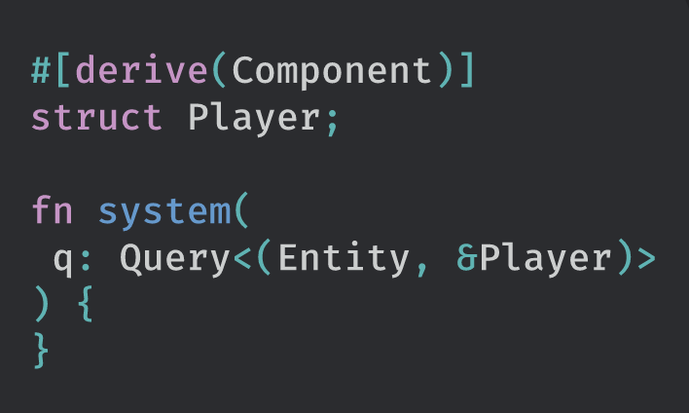

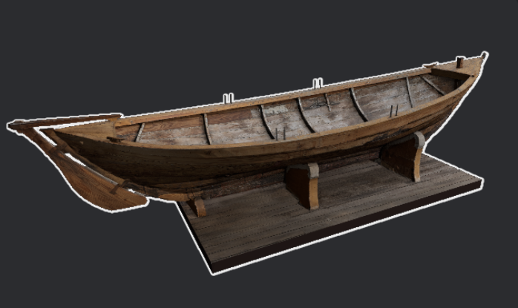

Introduce Bevy Engine
Bevy is a refreshingly simple data-driven game engine built in Rust.
It offers a complete 2D and 3D feature set.
Notes:
All engine and game logic uses Bevy ECS, a custom Entity Component System. Bevy ECS is Bevy's implementation of the ECS pattern. Unlike other Rust ECS implementations, which often require complex lifetimes, traits, builder patterns, or macros, Bevy ECS uses normal Rust datatypes. Bevy has a modern and flexible 3D renderer. It supports features such as lights, shadows, cameras, meshes, textures, and materials By using Bevy, you can load audio files and play them on demand. You can load audio files as Assets, or play audio Assets using the Audio resource.

Slide 5
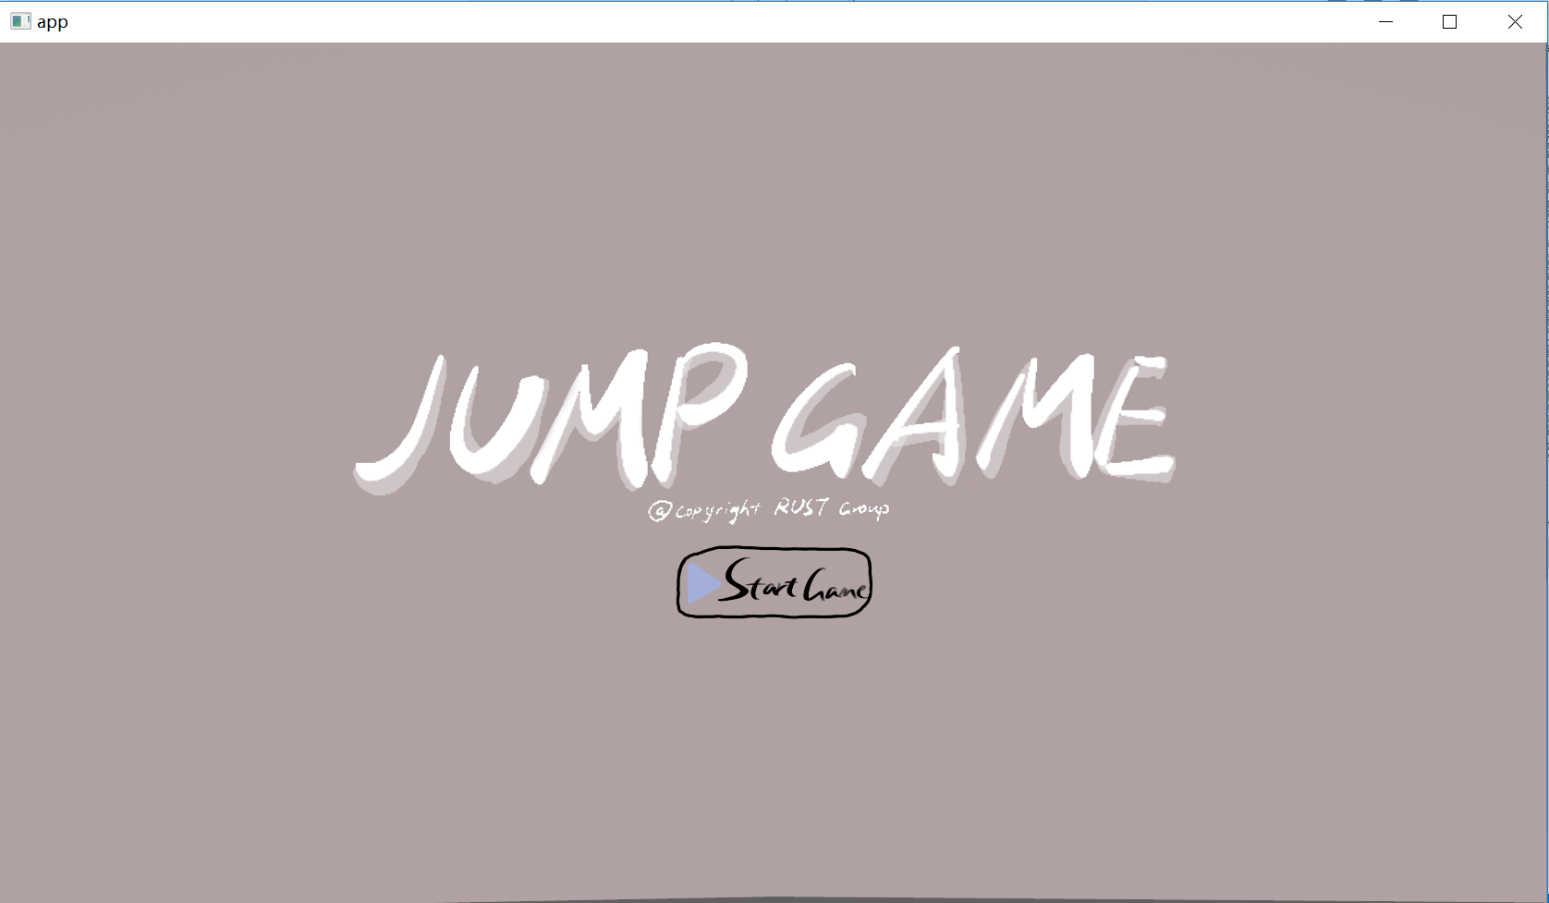
Main Page
Title
Start_game_button
Notes:
First I want to do a quick introduce about pages and entities in our game. The main page is simple, only title and start game button.

Slide 6
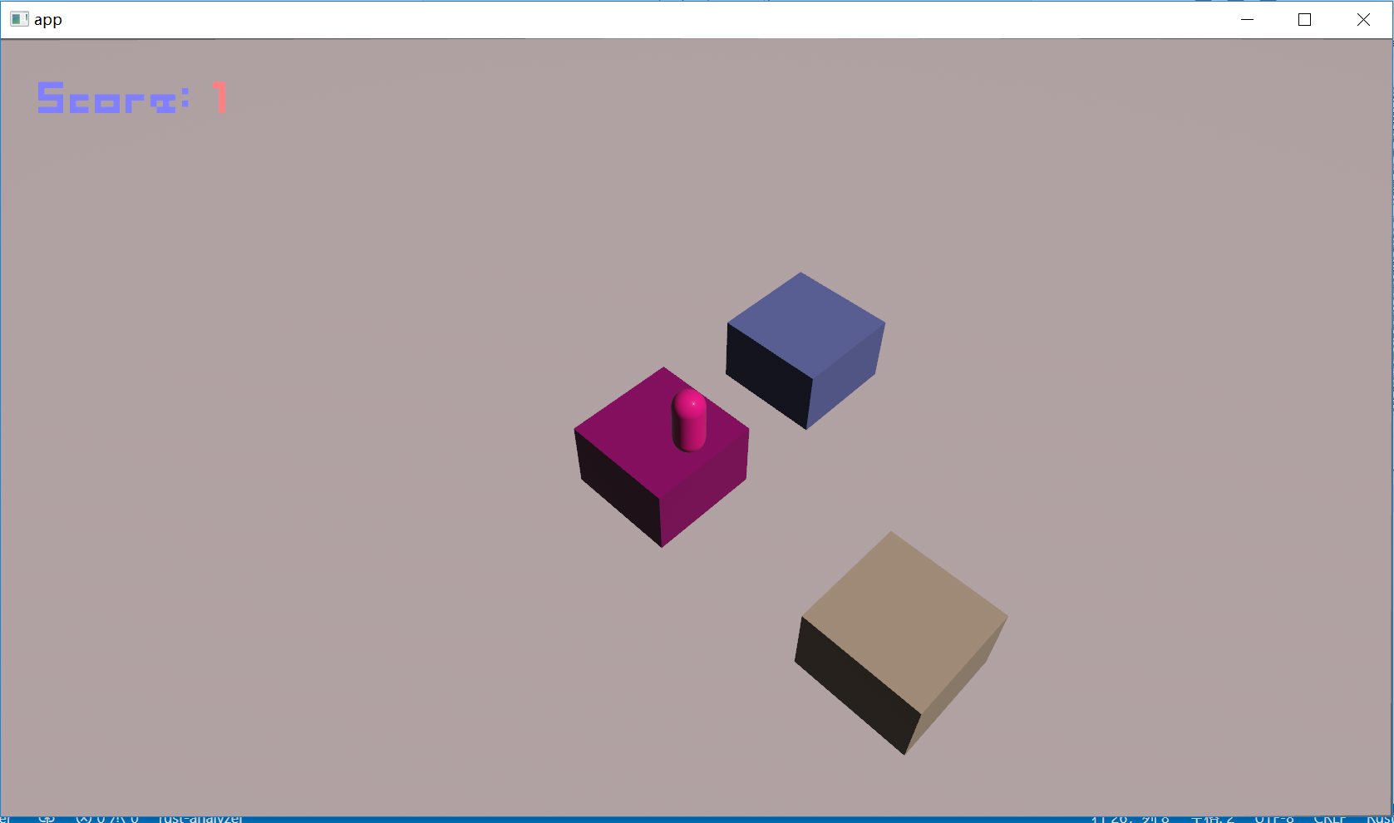
In Game
Player
Platform
Camera
UI
Notes:
In the game, we have two entity: player and platform. We also have ui design for different actions and animations. We need a camera to keep track of player.

Slide 7
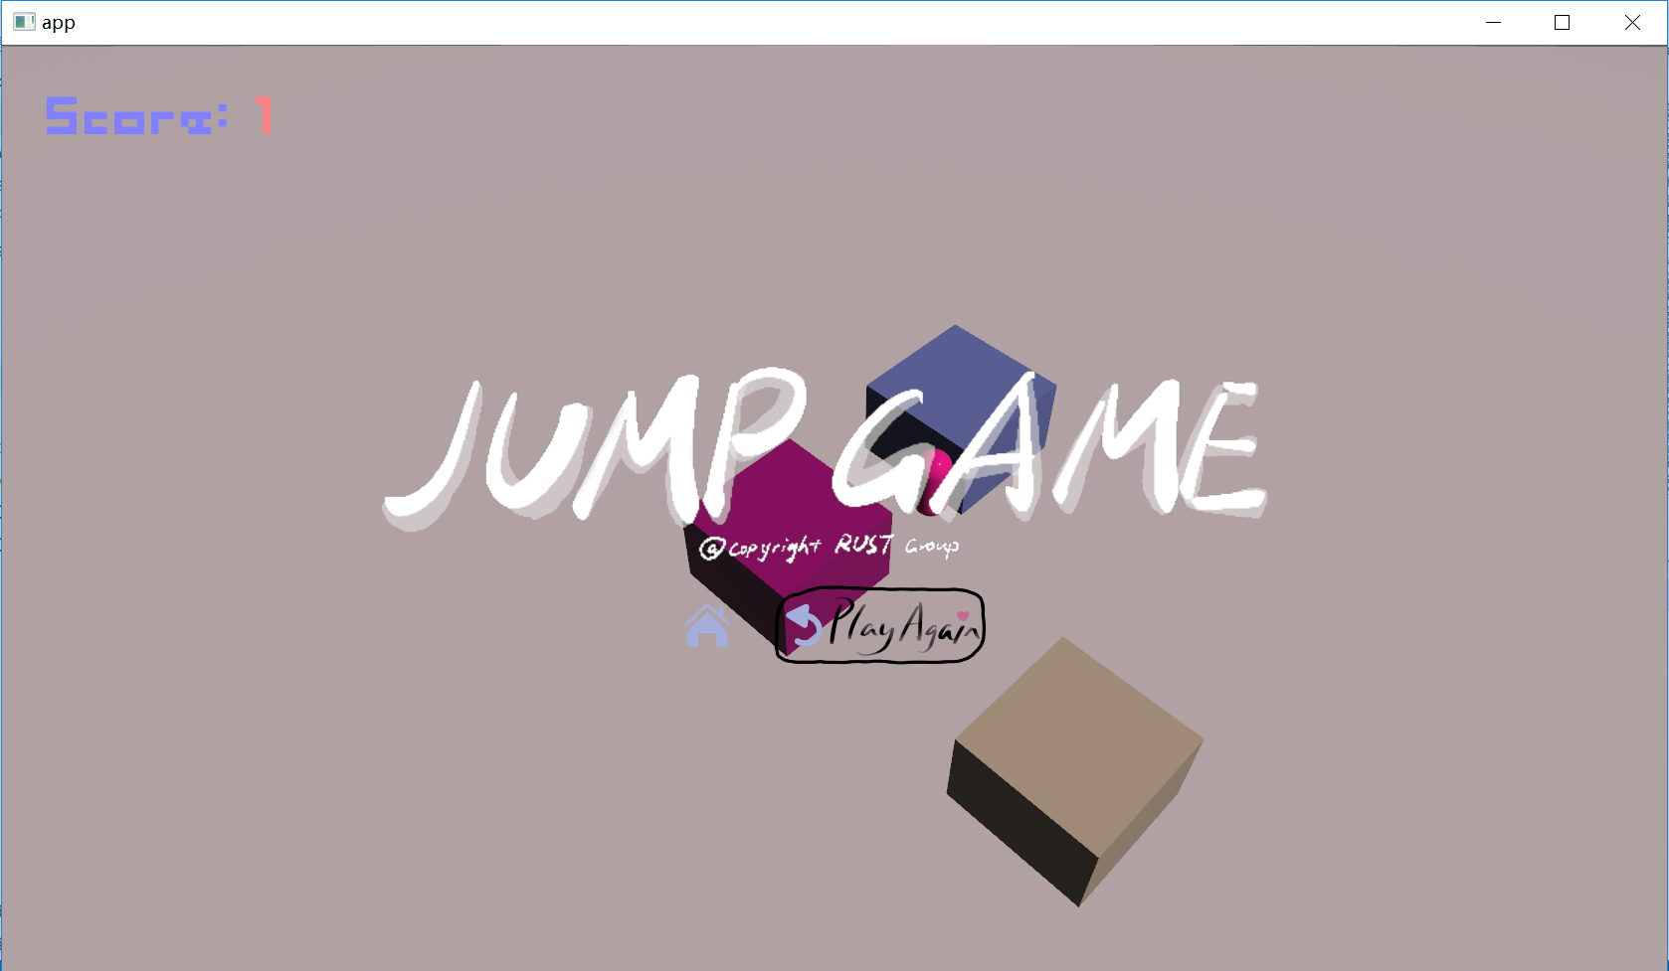
Game Over Page
Title
Restart_game_button
Return_home_button
Notes:
The game over page have title, restart button and home button. That’s it.

Slide 8
Overall Process
Land
Refresh
Main page
Initialize
Accumulate
Fall
Game Over
Notes:
Now I want to introduce our design process. We have two menus, start menu and game over menu. Our game started from start menu when we click ‘start game’ in this screen. Then the game will generate a random opening, with two blocks and one cylinder ‘player’ on starting block. Now the player accumulate power and release it using mouse. If we release it at the right time, we will land on the next block. We will see the score increases, the new block appears, and the camera moves according to our current location. The camera always follows player as the central of the screen. If we jump too far or too close that we don’t land on the platform, the cylinder will fall down. Then we will see the game over menu. Now we have two choices, play again or back to home page. If we click “play again”, it will generate a new opening. If we click the home button, it will bring us to the start menu. Both of these actions will empty your previous score.

Slide 9
Components and Structs
Main Page
Game State
Playing
Game Over
title
start
btn_start
accumulate
Image
Sound
btn_restart
land
btn_home
fall
Notes:
Here we have three game states: Main page, which is the initial screen; Playing, which is the process of playing the game; Game
Over, which is the end screen. We also apply images for ui design and buttons, and apply sounds in demand.

Slide 10
Player
Next block
Land
This block
Stationary
Accumulate
Jump
Straight
Fall
Forward
Tilt
Backward
Notes:
For the player, there are many actions that we need to figure it out. For example, if player accumulate too much power, the player will jump over the next platform. If player accumulate too little power, the player won’t jump on the platform. This is easy to think of, but what if the player have already touch the platform but eventually fall because more than half of the object is out of the platform. Instead of fall straight, in this situation, the object will tilt then fall, same as in reality. We need to make sure that the ‘tilt’ action is complete to continue the ‘fall’ action.
Animation and sounds are required in most of the states and actions. In this game, we design animation for accumulation, jump, and fall. Timer is required for calculating the distance we jump over. Tilt fall animation have two parts, it will tilt to one direction, and then fall straight. Sound is used to remind the player what is happening in this game. The sound of land and fall is different in order to distinguish themselves. We think it is necessary for player to know how far will I jump over according to their accumulation time, so we apply a special audio for accumulation to give player feedback on the auditory level. The longer the accumulation of force, the sharper the audio sounds.

Slide 11
Platform
There are two main actions about platform: generate new block and accumulation.
By using extern crate rand, we can set up a new platform in random distance, direction, and color.
Accumulation sound is not enough, we apply platform deformation in this document. As we accumulate power, the current platform will compress downward until we release player or the platform reach a limited degree.

Slide 12
Camera
We are using self-contained camera_3d from bevy engine, apply directional light, illuminance, shadow, and so on.
Only if we complete the jump or fall action, the camera will move.
Only if we land the next platform, the camera will follow the player, and place the player in the center of the shot.

Slide 13
Future Plan
Record player’s best score
Add ranking
Create a web-version

Slide 14
Thanks
Li Guan
Haoran Lyu
Satish Sarma Palepu
Weiwei Qin

